Slide 2
Deck Builder
A deck builder game is a game in which the goal is to construct a deck during the game that will allow the player or players to win the game. These can be competitive or cooperative.
In a typical deck builder game players play their entire hand and utilize any resources they acquire from that hand. There is also a market from which players can buy more cards. When a player buys a card they add that card to their discard pile and when they no longer have any cards to draw from their draw pile, their discard pile is shuffled and then becomes their draw pile.

Slide 3
Tower Defense
A tower defense game is a game in which a player places defensive towers along a set path that enemy minions will advance down at a set rate. The goal is to prevent any minions from reaching the end of the path by eliminating them all before they get there.
With this particluar tower defense game we had to figure out how to integrate a tower defense game with a deck builder.

Slide 4
Power Tower
Power Tower is a genre mashup game consisting of heavy elements from both tower defense and deck building genres.
Power Tower is a 2-player deck building tower defense game. Each player is given a turn on which they may purchase cards from the market with gold acquired from eliminating minions, through passive acquisition by currency towers, or through special cards that give gold. Cards can either place towers or activate powerful abilities that make the gameplay competitive and fun.

Slide 5
Idea
We originally came up with the idea to combine these 2 genres playing a number of deck building games such as Star Realms and Hero Realms. We were limited on the project ideas we could use so we chose to combine the tower defense game with a deck builder. We think this is a pretty unique idea. We’ve never seen another tower defense game that implements play with deck building concepts.

Slide 6
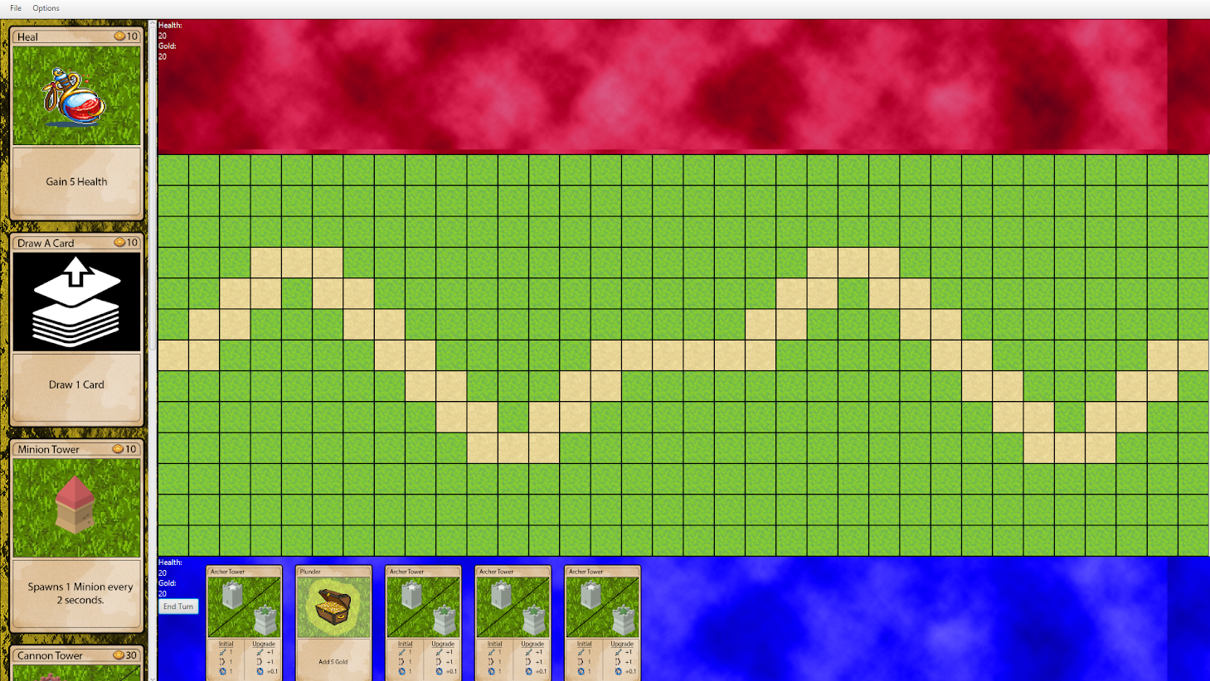
Game Board
Market
Game Grid
Player’s Hand

Slide 7
Game board (cont.)
The previous slide shows the basic layout of the game
-The market is on the right side of the board and is where cards can be purchased
-The top and bottom areas are the players’ zones and display current health, gold and cards currently in the players hands
-The center section is the main game board where towers can be placed and the minions will spawn

Slide 8
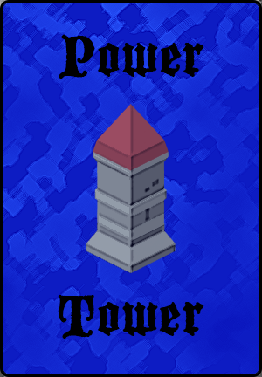
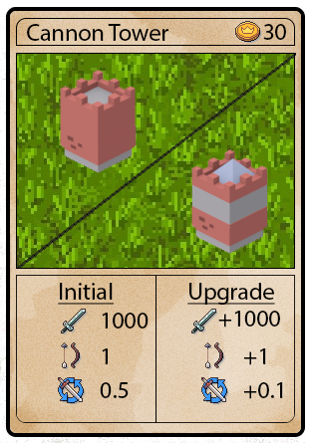
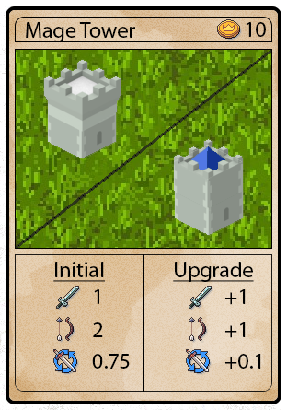
Art
All of the card art and splash screen was done by Chris Loper

Slide 9
Roles
Aramis - Networking and implementation of chat system/Handlers/Viewables
Ruben - Minion wave generation/path determination/GUI interaction
Chris - Art assets/card development/tower and ability implementation
Duncan - Implementation of minions and animation/GUI and menu generation
All members of the group put significant effort into almost all aspects of the game but, these were standout areas for each team member

Slide 10
Roadblocks
Implementing all the cards and making sure the decks work together
Buying cards
Implementing 2-player competitive play and even conceptualizing a 2-player tower defense game seeing as most are single player
Dealing with minions of different speeds

Slide 11
Things to do differently next time
Implementing this game using a GridPane seemed like a logical choice and we quickly built the entire game around the GridPane. The GridPane was great for placing towers and creating maps. In retrospect the Canvas would have made our lives a lot easier in the implementation of the game and handling animations.
We tried to complete as many aspects of the game at once before the necessary and primary stages were complete. This created some issues with testing and being able to run anything new we created. In retrospect it would have been easier to make sure we had a solid foundation before adding any new features.

Slide 12
Future
We would like to add some better balance to the game so, that certain towers aren’t so overpowered (as the project description asked for).
Implement more towers, ability cards, and minions
Make the graphics smoother and improve animations
Add dynamic pathing for the minions to allow for more complex paths

